Slide 1

Heart Disease Diagnostic Analysis
by
Bhanu Rekha

Slide 2
Introduction
Heart disease is a leading cause of mortality worldwide, emphasizing the need for effective early detection and prevention strategies.
This analysis aims to leverage data analytics techniques to develop predictive models for early detection and risk assessment of heart disease
.By identifying individuals at high risk and understanding the underlying factors, we can improve preventive measures and patient care, ultimately reducing the burden of heart disease on public health.

Slide 3
Data Description
Age
The person's age in years
Sex
The person's sex (1 = male, 0 = female)
Chest pain type
The chest pain experienced
Value 1: typical angina
Value 2: atypical angina
Value 3: non-anginal pain
Value 4: asymptomatic

Slide 4
Data Description
Resting blood pressure
The person's resting blood pressure (mm Hg on admission to the hospital)
Serum Cholesterol
The person's cholesterol measurement in mg/dl
Fasting blood sugar
The person's fasting blood sugar (> 120 mg/dl, 1 = true; 0 = false)
Thalach
maximum heart rate achieved

Slide 5
Data Description
Resting electrocardiographic results
Resting electrocardiographic measurement
0 = normal
1 = having ST-T wave abnormality
2 = showing probable or definite left ventricular hypertrophy by Estes' criteria
Exang
Exercise induced angina
Oldpeak
ST depression induced by exercise relative to rest

Slide 6
Data Description
Slope
the slope of the peak exercise ST segment
CA
The number of major vessels
Thal
A blood disorder called thalassemia
Target
Heart disease (0 = no, 1 = yes)

Slide 7
KPIS
246
Average Cholesterol
149.11
Average Heart Rate
131.61
Average Blood Pressure

Slide 8
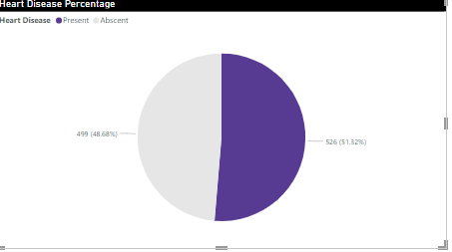
What kind of people do we have?
51% of people are suffering from heart Disease

Slide 9
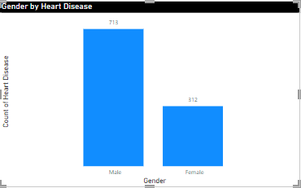
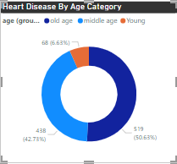
Who suffer from Heart Disease
Compared to females , males are highly Diagnoised
Old age people are highly effected

Slide 10
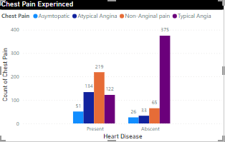
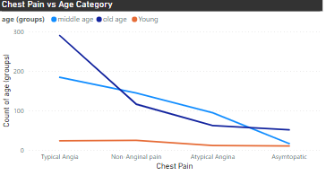
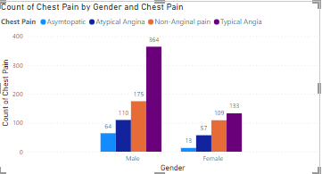
Chest Pain Experienced by People
People with heart disease are highly suffered from Typical Angina
Mostly old age people are highly Effected by Typical Angina
Mostly males are suffered by typical angina pain

Slide 11
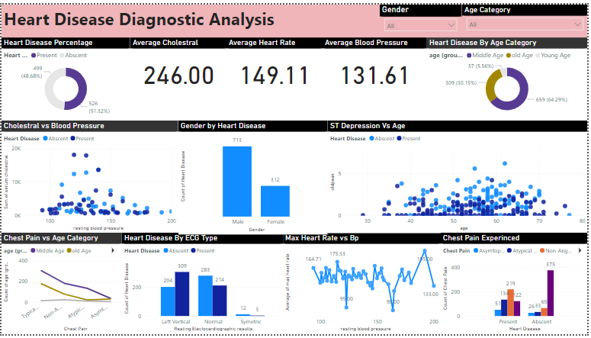
My Design

Slide 12
Conclusion
51% of people are suffering from heart disease
Males are more prone to heart disease
Old ages people are more prone to the heart disease
People having Typical Angina pain have a higher chance of heart disease
High number of cholesterol level in people having heart disease
Old age people will experience the chest pain
People with the Age group (50- 65) have high ST depression

Slide 13
THANK YOU

